Slide 1
Analysis of rare variants in complex trait association studies

Slide 2
Introduction
GWAS have been successful in detecting novel loci for complex traits:
typically characterised by common variants of modest effect;
together explain relatively little of the heritability.
Low-frequency (MAF 0.5-5%) and rare (MAF<0.5%) variation may contribute to the “missing heritability” of complex traits:
IFIH1 and type 1 diabetes;
MYH6 and sick sinus syndrome.

Slide 3
Rare variants and complex disease
Rare variants are likely to have arisen from founder effects in the last few generations.
Rare variants are expected to have larger effects on complex traits that common variants.
Single variant tests lack power to detect association.
Statistical methods focus on the accumulation of minor alleles at rare variants (mutational load) within the same “genomic unit”.

Slide 4
Defining a “genomic unit”
Focus on rare coding variants: direct biological interpretation.
All variants in same exon.
All coding variants within gene.
All variants within gene, extended to include UTRs.
Multiple genes in the same pathway.
“Sliding window” of variants (irrespective of annotation) across the genome.

Slide 5
Classes of rare variant tests
Cases
Burden tests
Assume same direction of effect of all rare variants on outcome.
Dispersion tests
Allow for different directions of effect of rare variants on outcome
Controls
0
1
2
3
4
5
6
Number of minor alleles
Cases
Controls
0
1
2
3
4
5
6
Number of minor alleles

Slide 6
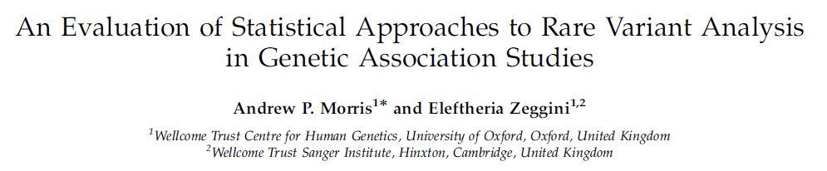
Burden test: GRANVIL
Test of association of phenotype with proportion of rare variants at which individuals carry minor alleles.
Model disease phenotype via regression on p_{i} and any other covariates in GLM framework.
1 0 0 0 0 1 0 0 0 1 p_{i} = 3/10
Reedik Magi
http://www.well.ox.ac.uk/GRANVIL/

Slide 7
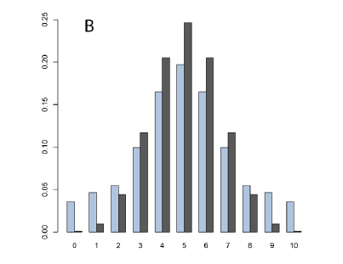
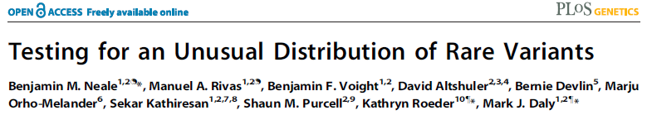
C-alpha
Under the null hypothesis, a minor allele at a rare variant is equally likely to appear in a case as in a control (unbiased coin).
Under the alternative, minor alleles at risk variants are more likely to appear in cases, and minor alleles at protective variants are more likely to appear in controls.
Tests that assume same direction of effect assess evidence that coin is biased on average.
C-alpha tests for evidence of a mixture of binomial distributions, i.e. presence of overdispersion in distribution of minor alleles at rare variants in cases and controls.

Slide 8
Dispersion tests
Most methods developed that allow different directions of effect of variants are generalisations of the C-alpha approach.
SKAT can be applied to dichotomous and/or quantitative traits, and can accommodate covariates.
SKAT is most powerful dispersion test for detecting rare variant association over a wide range of genetic architectures: relatively robust to the presence of non-causal variants.

Slide 9
Classes of rare variant tests
Cases
Burden tests
Mean number of minor alleles higher (lower) in cases than controls.
Greatest power when all variants in gene have same effect on disease.
Dispersion tests
Variance in number of minor alleles higher (lower) in cases than controls.
Greatest power when variants in gene have different effect on disease.
Controls
0
1
2
3
4
5
6
Number of minor alleles
Cases
Controls
0
1
2
3
4
5
6
Number of minor alleles
SKAT-O combines features of burden and dispersion tests and has been demonstrated to be powerful over a range of genetic models.

Slide 10
Variant group files and weights
Loss in power through inclusion of neutral variants in a genomic unit.
Develop “group files” for each genomic unit that define included variants:
MAF threshold (<5%, <1%, <0.5%);
annotation (coding variants, protein truncating variants).
Some tests form groups of variants that are analysed together: CMC first clusters variants by MAF, and then combines statistics with Hoteling’s T-statistic.
Some tests incorporate weights for each variant based on MAF and annotation.
Madsen & Browning burden test weights each variant by 1/(MAF*(1-MAF)).
Relative power of different masks will depend on underlying genetic architecture of trait.

Slide 11
Assaying rare genetic variation
Gold-standard approach to assaying rare genetic variation is through re-sequencing, which is expensive on the scale of the whole genome.
GWAS genotyping arrays are inexpensive but are not designed to capture rare genetic variation. However, we can impute into GWAS scaffolds up to large-scale reference panels (1000 Genomes Project) to recover genotypes at rare variants at no additional cost, other than computation.
Exome genotyping arrays: cost effective assay of low-frequency and rare coding variants.

Slide 12
GRANVIL: imputed variants
Test of association of phenotype with proportion of rare variants at which individuals carry minor alleles.
Replace direct genotypes with posterior probability of heterozygous or rare homozygous call from imputation.
Model disease phenotype via regression on p_{i} and any other covariates in GLM framework.
0.9 0.1 0.2 0.1 0.1 0.8 0.1 0.1 0.1 0.6 p_{i} = 3.0/10

Slide 13
Rare variant calling and QC
Rare variants more challenging to call than common SNPs: more difficult to distinguish heterozygotes from common homozygotes.
Imputed rare variants: more stringent thresholds for imputation quality?
Exome array genotyping: additional calling methods (zCALL) and second round of QC.
Important to always check quality of rare variant genotyping through visual inspection of cluster plots.

Slide 14
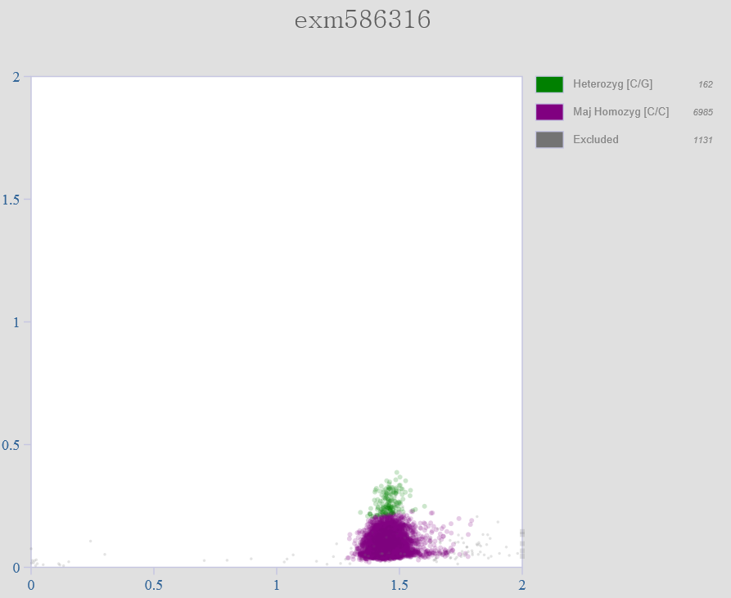
Bad cluster plot

Slide 15
Accounting for population structure and cryptic relatedness
Rare variants more likely to be confounded with fine-scale population structure.
Apply traditional GWAS approaches to account for structure and cryptic relatedness:
Remove “related” individuals and adjust for principal components as covariates in regression model.
Use linear mixed model with an empirically estimated relatedness matrix to model the correlation between outcome of samples.

Slide 16
SAIGE(-GENE)
Implements single variant tests and gene-based burden and dispersion tests (and SKAT-O).
Developed in regression framework, so can account for confounding by inclusion of covariates.
Implements mixed model to account for population structure and cryptic relatedness.
User provides variant “group files” for each test: provides annotation (and optionally weight) for each variant.
Analysis run in two steps: fitting null model and fitting alternative model.

Slide 17
More software…
SMMAT: logistic mixed model for binary traits.
REGENIE: implements burden, SKAT and SKAT-O tests in computationally efficient model allowing for case-control imbalance in binary traits.
EPACTS: flexible suite of software tools for single variant and gene-based analysis, implementing linear mixed model.
RareMetal(Worker): analysis and meta-analysis of rare variant association tests.

Slide 18
Contribution of coding variants to fasting glycaemic traits
GoT2D/T2D-GENES Consortium combined exome array data from 33,392 non-diabetic European individuals from 14 studies to:
Identify novel rare coding variants associated with glycaemic traits: glucose and insulin.
Evaluate the role of rare coding variants at known GWAS loci for fasting glycaemic traits.
Highlight causal transcripts and characterise molecular mechanisms influencing glycaemic traits

Slide 19
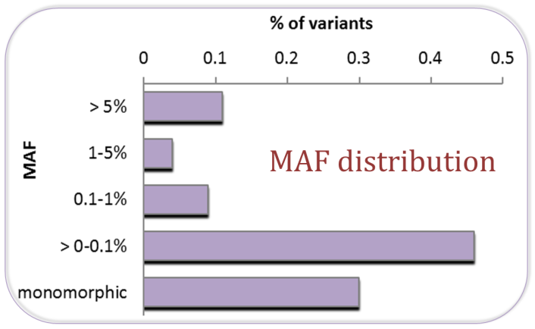
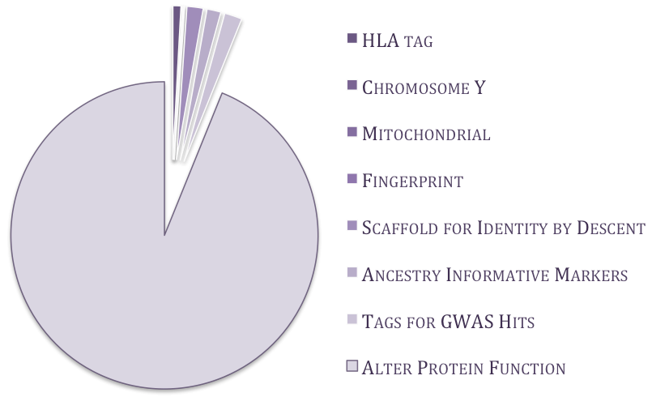
Exome array: cost-effective alternative to explore low-frequency and rare coding variants
Incorporates ~248,000 variants identified in >12,000 sequences.
Represents >80% coding variation (MAF>0.5%) in European ancestry populations.

Slide 20
Gene-based analysis of rare protein altering variants
G6PC2 associated with FG at exome-wide significance (p<2.5x10⁻⁶) in burden and dispersion tests.
Gene contains 13 protein altering variants (MAF<5%).
Gene-based association signal primarily driven by p.His177Tyr and p.Tyr207Ser.
Distinct from common variant GWAS signal at this locus.
Conditioning variants | SKAT | BURDEN
Unconditional | 6.1x10⁻¹⁰ | 2.1x10⁻¹⁶
p.His177Tyr | 2.6x10⁻⁶ | 8.3x10⁻¹⁰
p.His177Tyr and p.Tyr207Ser | 0.00025 | 0.00021
p.His177Tyr, p.Tyr207Ser, and p.Ile171Thr | 0.015 | 0.014
p.His177Tyr, p.Tyr207Ser, p.Ile171Thr, and p.Ser324Pro | 0.44 | 0.30

Slide 21
G6PC2/ABCB11 locus
Both G6PC2 and ABCB11 have been considered strong biological candidates for glucose regulation.
No evidence of association of FG with coding variants in ABCB11 (alone or in aggregate).
G6PC2 encodes the glucose‐6‐phosphatase catalytic domain that is specifically expressed in pancreatic islet beta cells.
Loss of this gene in mice results in lowered FG levels suggesting an important role for this enzyme in glucose regulation.

Slide 22
Summary
Rare genetic variants may account for a proportion of the “missing heritability” of complex human traits.
Statistical methods focus on the accumulation of minor alleles at rare variants (mutational load) within the same “genomic unit”.
The most powerful rare variant test will depend on the underlying genetic architecture of the trait.
Rare variants can be captured through re-sequencing, exome array genotyping, and imputation into GWAS scaffolds.
Novel discoveries for genetic basis of complex human traits emerging through analysis of rare variants.

